Slide 1

Problem Statement(s)
We are Team Number 35
Only industry where a loyalty program does not exist is Media & Entertainment.
Design a Loyalty Program for the Same.

Slide 2
Problem Statement(s)
We are Team Number 35
The Recommendation Engines are broken. Can we fix them? Choice and popular are different. Recommending is getting the choice correct. Model the best recommendation engine.

Slide 3
Our needs
User needs
Keep Customer hooked to our platform.
To Find new and Creative Content
Persuade User to watch promoted content
To watch what they want (not our suggestions)
Get Relatable suggestion quickly.
Fulfil our viewership target
To get rewarded for spending their time.

Slide 4
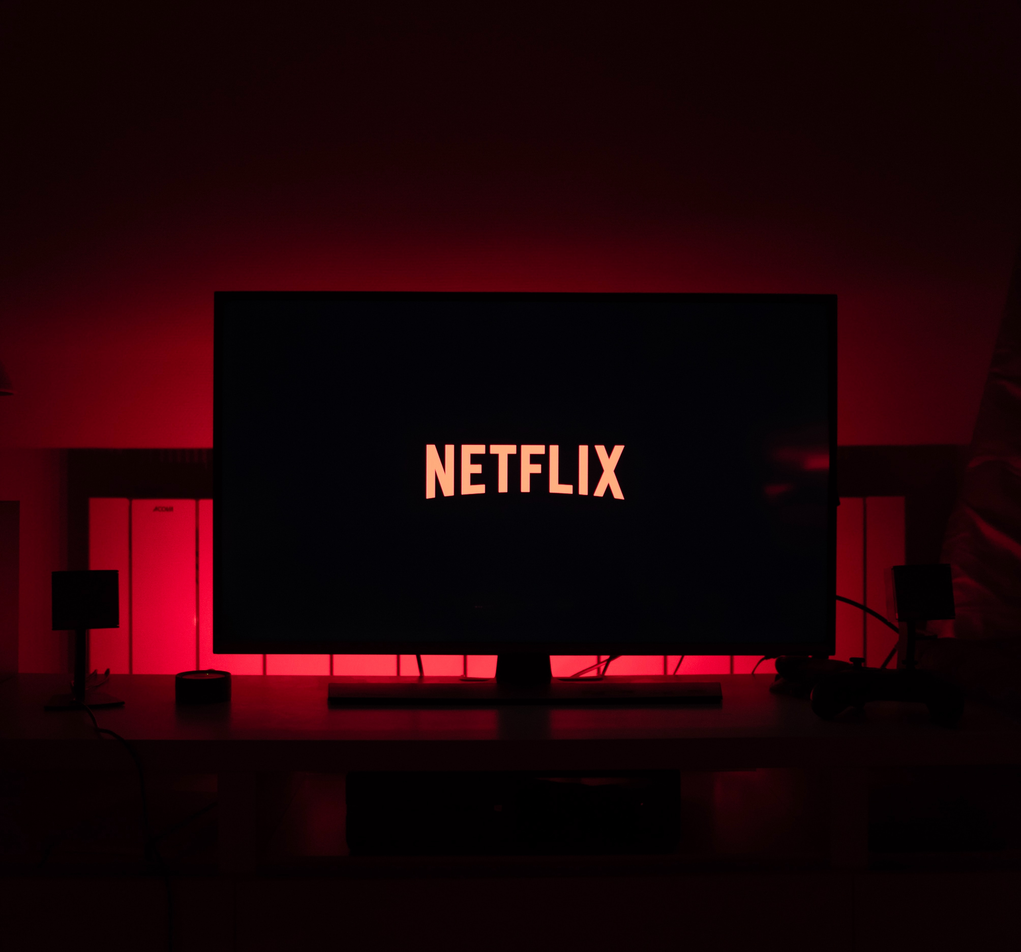

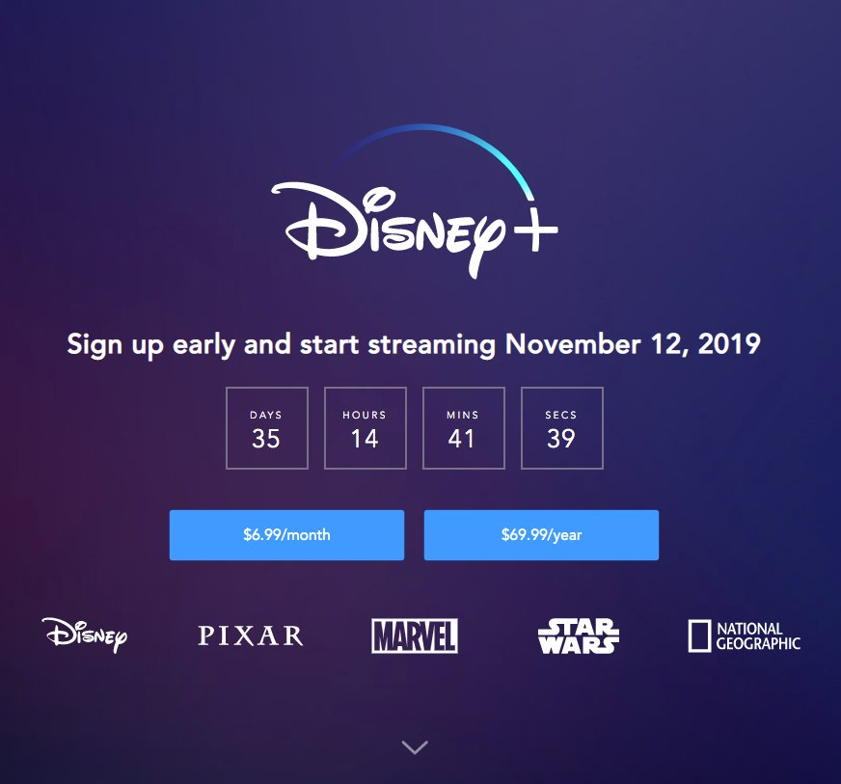
Where are Loyalty Programs already Prevalent?
Medium Scale Physical Shop
Items which usually comes with Coupon (Ex. Newspaper, Magazines)

Slide 5
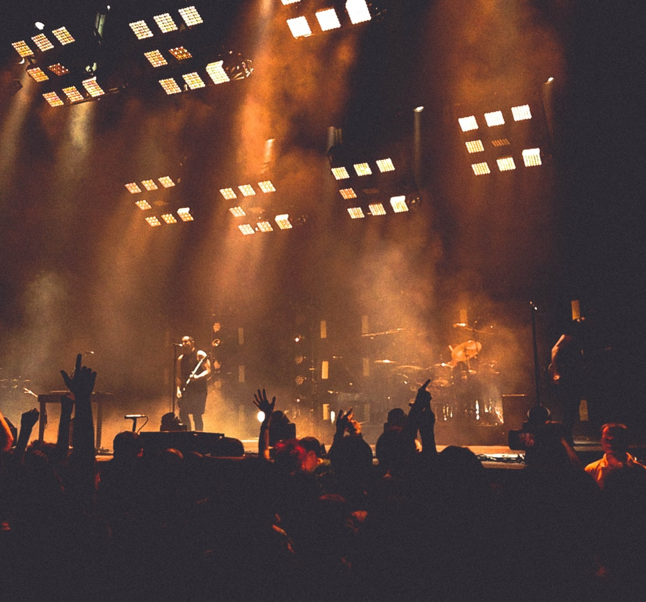
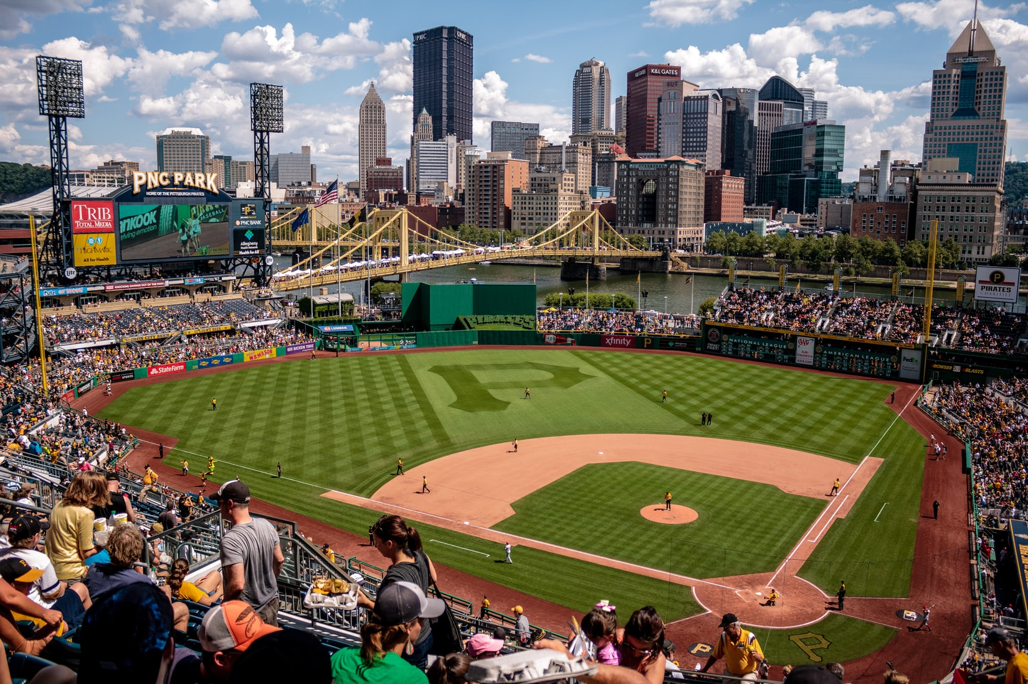

Why is it difficult to design loyalty program
for media and Entertainment in Current Context?
Presence of Physical Units such as TV’s and CD’s. So these are one time purchases with no feedback.

Slide 6
How are current recommendation systems broken?
Preferences are fluid.
Current recommendation systems can be hacked: Manipulated descriptions.

Slide 7
What we bring to the table?
Cold Start and Grey Sheep are taken care by Mood Based Recommendations.
Loyalty Based Recommendations helps to mold the user for our benefits.
Personalised User Library System for User Retention.

Slide 8
Fan identification
- Viewer gets recognised
- Fan gets quizzed
- Superfan gets rewarded

Slide 9
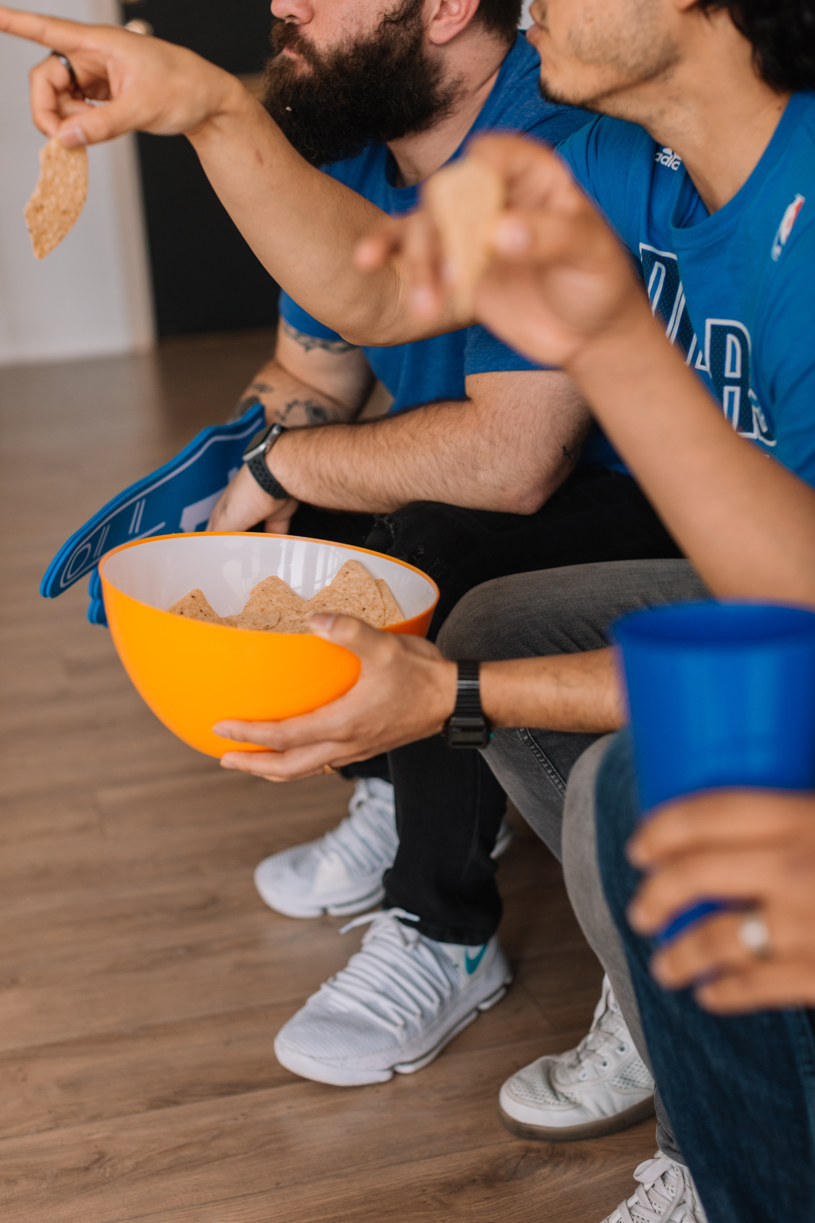
Loyalty programme:
- Based on mood
- Rewatch to keep your status
- Requiz to keep your status. Get a chance to win prizes
- Watch similar sponsored content to get a chance to win prizes

Slide 10
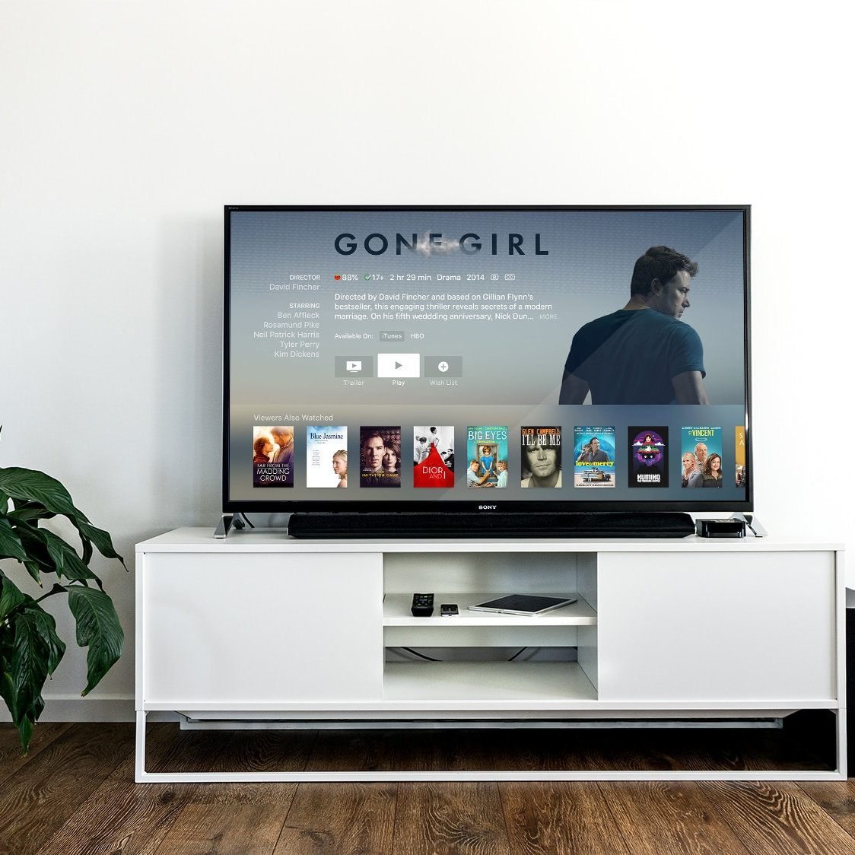
Originals
Watch One more Original Series this Week
Producers (WB, HBO)
They will pay us to promote their contents.
O
P
Types of OTT Platform
Fan Level
The nerdy knowledge can be used to win redeemable gifts
Advertisement
Targeted Recommendation for Revenue.
F
A

Slide 11
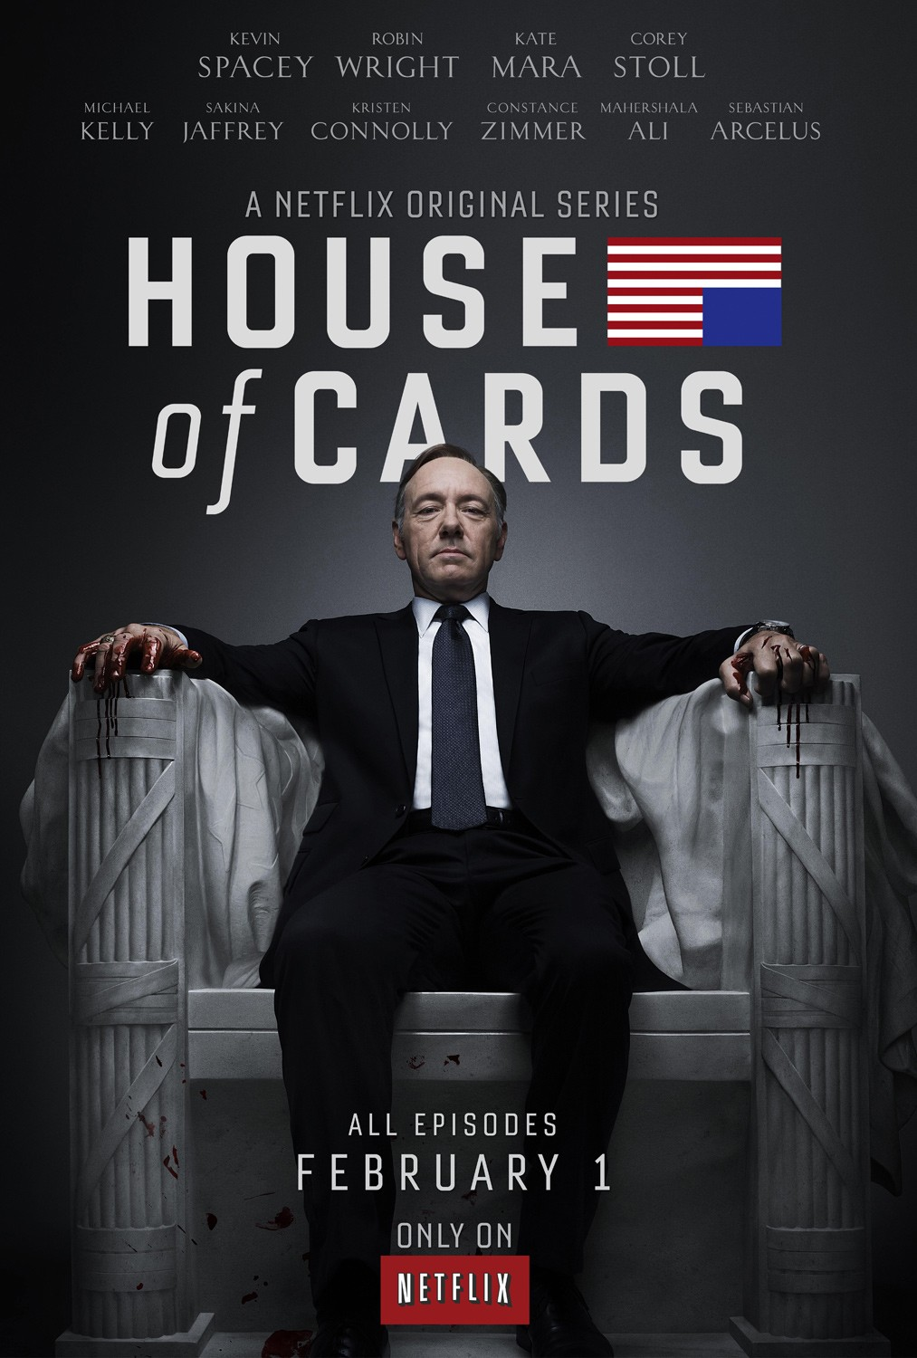
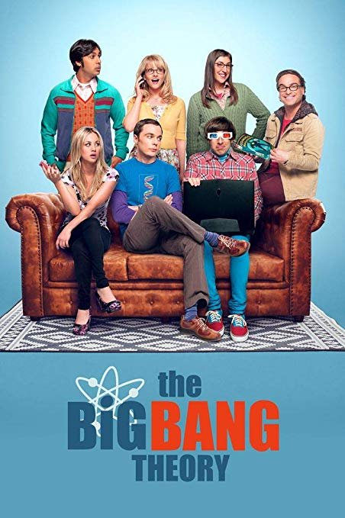
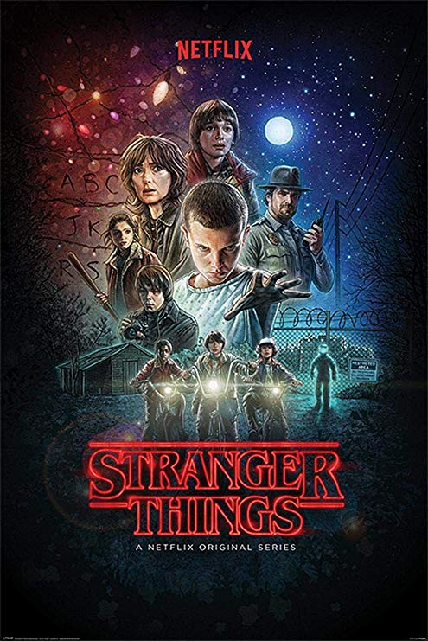
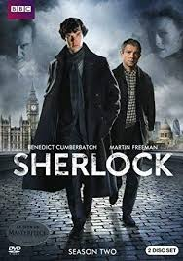




How we Solve this Problem in Current Context?
In the Current context we have a benefit in the form of knowing what user watches regularly. Using the Loyalty+Mood Based Recommendation system we will solve this problem.
1. Subscription Level
2. Originals Level
3. Producer Level

Slide 12
Technologies Used
1. IBM Watson Tone Analyzer
2. TMDb: The Python Movie Database
3. Django

Slide 13
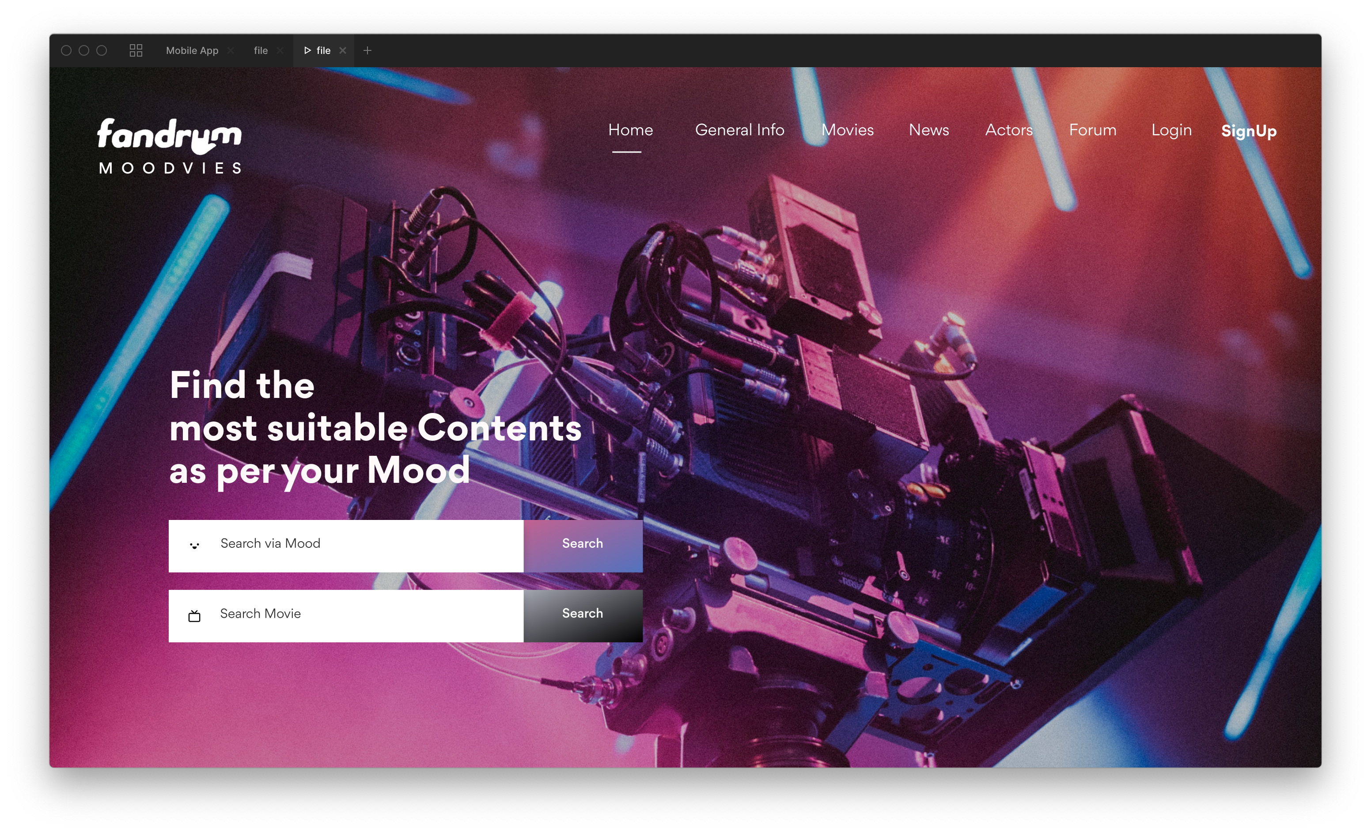

Slide 14
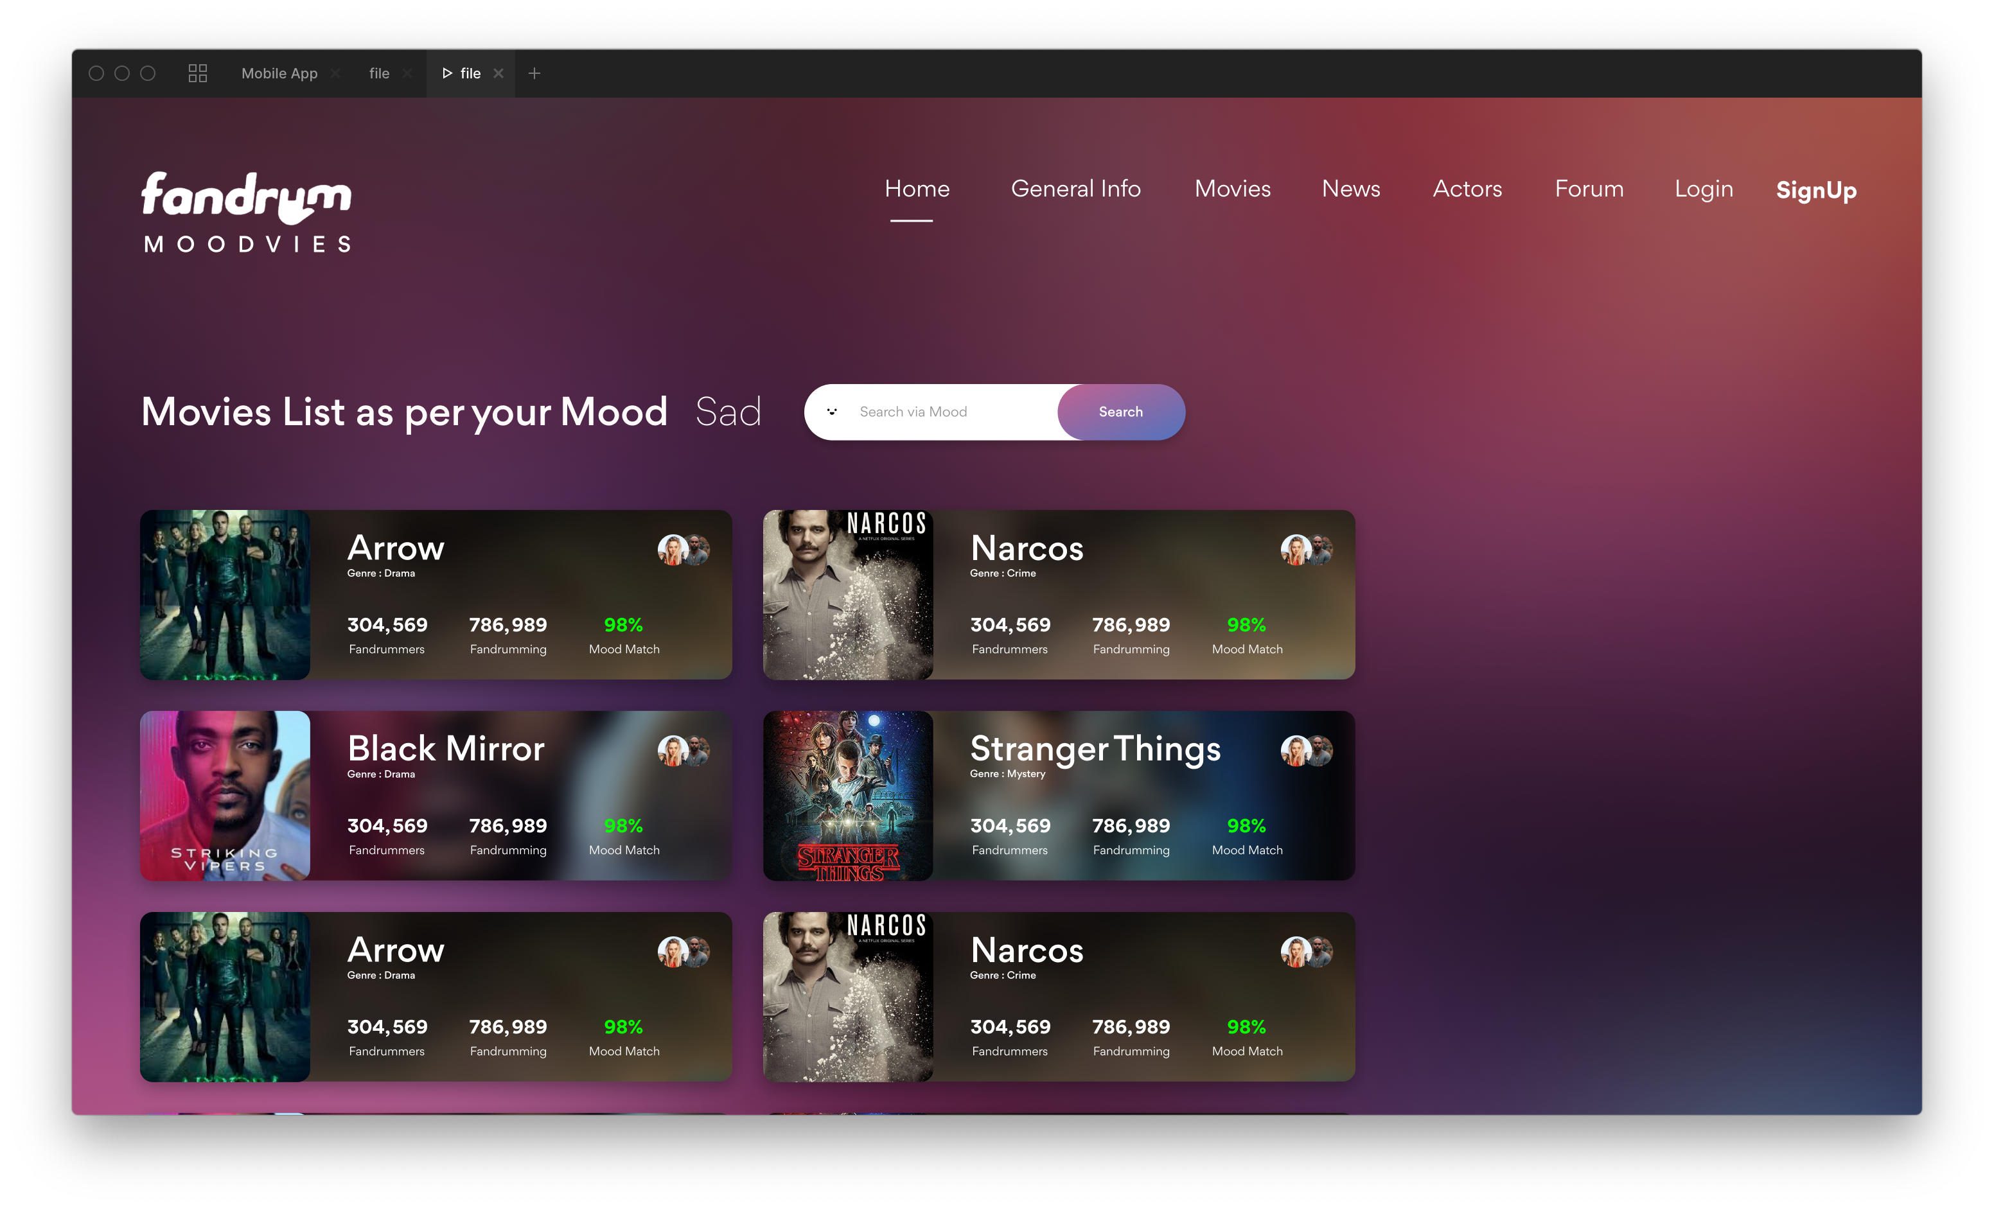

Slide 15
THANK YOU!

